Slide 1








Next-Gen Early Career Scientist Session
A Decade of Extrahepatic Oligonucleotide Delivery
Keynote talk by
Maire Jung, Ph.D.
Eli Lilly
Mahnoush Bahjat Ph.D.
AstraZeneca
Riccardo Panella
Ph.D.
Aalborg University
Reka Haraszti
Ph.D.
University Hospital Tubingen
Sankha Pattanayak
Ph.D.
Creyon Bio
Sunit Kumar Jana
Ph.D.
McGill University
Andrei Korostelev
Ph.D.
UMass Chan Medical School

Slide 2
October 6, 2024
A Decade of Therapeutic Oligonucleotide Delivery
Maire F. Jung, PhD
Vice President and Chief Scientific Officer, RNA
Lilly Institute of Genetic Medicine

Slide 3




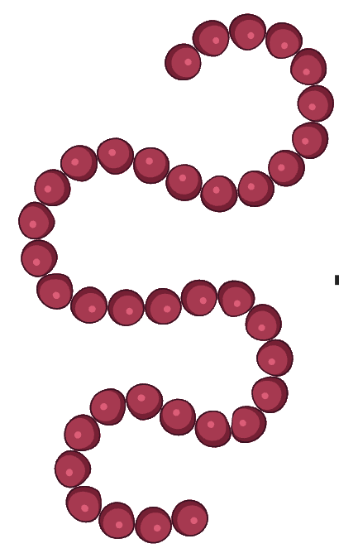
Protein Sequence is Encoded in DNA and Regulated by RNA
Transcription
Splicing
Translation
Folding
Polypeptide
Pre-mRNA
mRNA
Protein
DNA
Notes:
I’m sure you’re familiar with the central dogma, but I thought I’d refresh in order to further highlight some of the advances that have been made recently in RNA therapeutics. On the left is a DNA genome, which is transcribed into pre-mRNA, which is spliced and exported out of the nucleus to form a mature mRNA. mRNA is translated by the ribosome into a polypeptide, which is folded by additional processing machinery into a functional protein. I’ve highlighted in purple the different ways that synthetic oligonucleotides can be used to address pathogenic mutations or processes at each step in this process. Disease causing mutations in DNA can be corrected using CRISPR. In select cases, disease-associated mRNAs can be edited or spliced to change the function of the produced protein. One of the most validated mechanisms of gene modulation in the clinic is mRNA silencing via siRNA or antisense oligonucleotides. We also have the ability to use exogenous transfer RNA to help ribosoms read through stop codons to increase protein expression. Finally, aptamers can be generated with very high affinity and specificity towards final protein structures, with applications both in therapeutics and diagnostics. Today, we’ll be focusing on recent advances in siRNA.

Slide 4
So Why Do Conventional Drug Modalities Only Target Protein?
Agonism & Antagonism
Antibodies
Transcription
Splicing
Translation
Folding
Polypeptide
Inhibition & Activation
Small Molecules
Pre-mRNA
mRNA
Protein
DNA
Traditional Modalities:
Make medicines from atoms and amino acids
Notes:
I’m sure you’re familiar with the central dogma, but I thought I’d refresh in order to further highlight some of the advances that have been made recently in RNA therapeutics. On the left is a DNA genome, which is transcribed into pre-mRNA, which is spliced and exported out of the nucleus to form a mature mRNA. mRNA is translated by the ribosome into a polypeptide, which is folded by additional processing machinery into a functional protein. I’ve highlighted in purple the different ways that synthetic oligonucleotides can be used to address pathogenic mutations or processes at each step in this process. Disease causing mutations in DNA can be corrected using CRISPR. In select cases, disease-associated mRNAs can be edited or spliced to change the function of the produced protein. One of the most validated mechanisms of gene modulation in the clinic is mRNA silencing via siRNA or antisense oligonucleotides. We also have the ability to use exogenous transfer RNA to help ribosoms read through stop codons to increase protein expression. Finally, aptamers can be generated with very high affinity and specificity towards final protein structures, with applications both in therapeutics and diagnostics. Today, we’ll be focusing on recent advances in siRNA.

Slide 5
Genetic Medicines Can Better Address the Root Cause of Disease
DNA Editing
CRISPR
mRNA Silencing
siRNA, ASO
Agonism & Antagonism
Antibodies
RNA Editing
ADAR
Protein Binding
Aptamer
Translation
Modulation
tRNA
Splice Modulation
ASO
Transcription
Splicing
Translation
Folding
Polypeptide
Inhibition & Activation
Small Molecules
Pre-mRNA
mRNA
Protein
DNA
Genetic Medicines:
Make medicines from nucleotides
Traditional Modalities:
Make medicines from atoms and amino acids
Notes:
I’m sure you’re familiar with the central dogma, but I thought I’d refresh in order to further highlight some of the advances that have been made recently in RNA therapeutics. On the left is a DNA genome, which is transcribed into pre-mRNA, which is spliced and exported out of the nucleus to form a mature mRNA. mRNA is translated by the ribosome into a polypeptide, which is folded by additional processing machinery into a functional protein. I’ve highlighted in purple the different ways that synthetic oligonucleotides can be used to address pathogenic mutations or processes at each step in this process. Disease causing mutations in DNA can be corrected using CRISPR. In select cases, disease-associated mRNAs can be edited or spliced to change the function of the produced protein. One of the most validated mechanisms of gene modulation in the clinic is mRNA silencing via siRNA or antisense oligonucleotides. We also have the ability to use exogenous transfer RNA to help ribosoms read through stop codons to increase protein expression. Finally, aptamers can be generated with very high affinity and specificity towards final protein structures, with applications both in therapeutics and diagnostics. Today, we’ll be focusing on recent advances in siRNA.

Slide 6
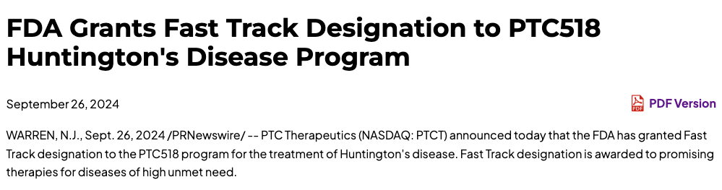
Designing Molecules to Specifically Target RNA is Difficult…
… But breakthroughs happen every day!
Transcription
Splicing
Translation
Folding
Polypeptide
Inhibition & Activation
Small Molecules
Pre-mRNA
mRNA
Protein
DNA
Notes:
I’m sure you’re familiar with the central dogma, but I thought I’d refresh in order to further highlight some of the advances that have been made recently in RNA therapeutics. On the left is a DNA genome, which is transcribed into pre-mRNA, which is spliced and exported out of the nucleus to form a mature mRNA. mRNA is translated by the ribosome into a polypeptide, which is folded by additional processing machinery into a functional protein. I’ve highlighted in purple the different ways that synthetic oligonucleotides can be used to address pathogenic mutations or processes at each step in this process. Disease causing mutations in DNA can be corrected using CRISPR. In select cases, disease-associated mRNAs can be edited or spliced to change the function of the produced protein. One of the most validated mechanisms of gene modulation in the clinic is mRNA silencing via siRNA or antisense oligonucleotides. We also have the ability to use exogenous transfer RNA to help ribosoms read through stop codons to increase protein expression. Finally, aptamers can be generated with very high affinity and specificity towards final protein structures, with applications both in therapeutics and diagnostics. Today, we’ll be focusing on recent advances in siRNA.

Slide 7














Lilly’s Journey in Genetic Medicine
2018-2021: Establishing siRNA platform
2021-2024: Expand modalities & engage leaders
2019
2020
2021
2022
2023
2024
Nucleic acids
Gene therapy/delivery
Gene editing
2024 and beyond: Focus on the delivery challenge to enable novel modalities
Vision: To make lives better with RNA medicine
Notes:
I’m sure you’re familiar with the central dogma, but I thought I’d refresh in order to further highlight some of the advances that have been made recently in RNA therapeutics. On the left is a DNA genome, which is transcribed into pre-mRNA, which is spliced and exported out of the nucleus to form a mature mRNA. mRNA is translated by the ribosome into a polypeptide, which is folded by additional processing machinery into a functional protein. I’ve highlighted in purple the different ways that synthetic oligonucleotides can be used to address pathogenic mutations or processes at each step in this process. Disease causing mutations in DNA can be corrected using CRISPR. In select cases, disease-associated mRNAs can be edited or spliced to change the function of the produced protein. One of the most validated mechanisms of gene modulation in the clinic is mRNA silencing via siRNA or antisense oligonucleotides. We also have the ability to use exogenous transfer RNA to help ribosoms read through stop codons to increase protein expression. Finally, aptamers can be generated with very high affinity and specificity towards final protein structures, with applications both in therapeutics and diagnostics. Today, we’ll be focusing on recent advances in siRNA.

Slide 8







































We and Others Are Invested in Making the siRNA Dream a Reality
Launched
Phase 3
Phase 2
Phase 1
* Non-exhaustive list
Key partner companies presented separately
Notes:
We and others are committed to making the siRNA dream a reality

Slide 9
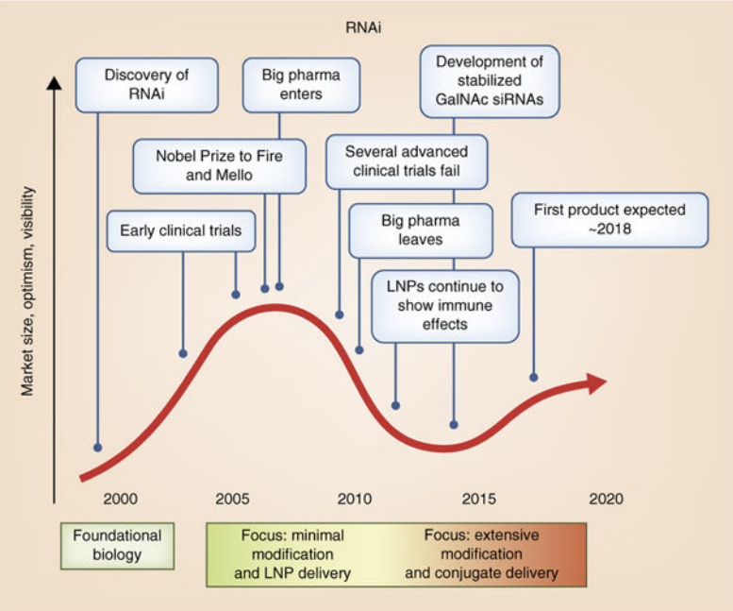

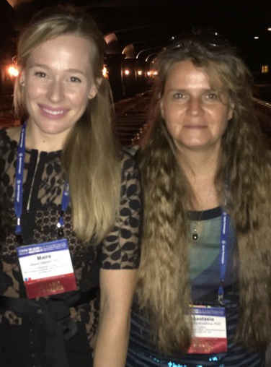
The Technology Evolution of siRNA Therapeutics
Six siRNA approvals (liver)
Additional siRNA approvals expected across multiple indications and tissues
Second CNS siRNA Ph1 announced (ARWR)
Multiple siRNAs advanced to clinic in extrahepatic tissues (lung, muscle)
First CNS siRNA administered in clinic (ALNY)
2025+
Focus: Deepening our knowledge in RNA chemistry, emergence of potent protein and small-molecule shuttles, and first clinical data in novel tissues
Adapted from Khvorova & Watts, Nat. Biotechnol., 2017 and not to scale

Slide 10




siRNA Clinical Success Enabled by Foundational Investments in Chemistry
RNA Chemistry
Architecture
Conjugation

Slide 11
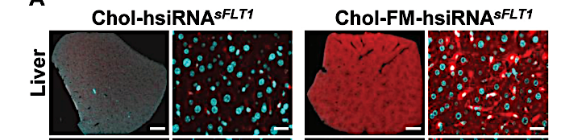
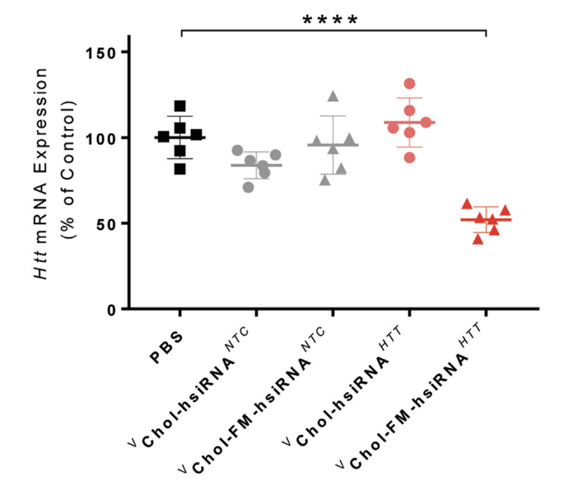
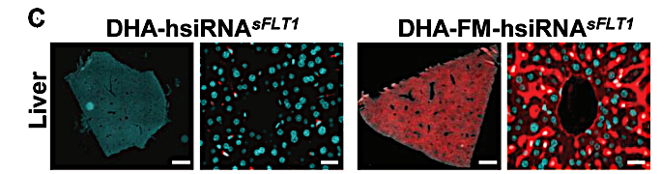
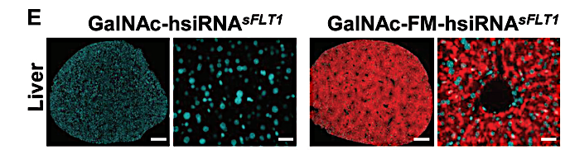
RNA Chemical Modifications Have Unlocked Clinical Efficacy
six!
“All 18 nucleic acid therapeutics that have reached the market to date, including the [five siRNAs], four antisense oligonucleotides, five splice site switching oligonucleotides, an anti-VEGF aptamer, an HBV vaccine adjuvant, and the two COVID-19 mRNA vaccines have chemical modifications.”
Egli et al, RNA, 2023
2’ Modifications Improve siRNA Exposure
Regardless of Conjugate
2’ Modifications Improve siRNA Potency
Hassler et al, NAR, 2018

Slide 12
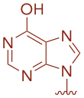
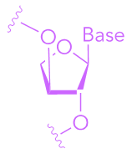
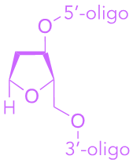
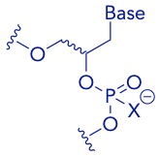
siRNA Chemical Optimization on an Atomic Scale*
Backbone Modifications
Improve Nuclease Stability
Tune Protein Binding
Neutralize Charge
Tune Lipophilicity
Base Modifications
Reduce Off-Target Liability
Thermal Stabilization
Adenine
Uracil
Cytosine
Guanine
Inosine
Abasic
Ribose Modifications
Reduce Immunogenicity
Improve Stability and Potency
(R/S)-Phosphorothioate
DNA
2’-OMe
2’-F
2’-MOE
LNA
(S)-cEt
(R/S)-Mesyl
Phosphorodithioate
Acyclic Modifications
Thermal Destabilization
Linkage Modifications
Improve Stability and Off-Target Liability
(R/S)-Phosphorylguanidine
(E)-Vinylphosphonate
UNA
(R/S)-GNA
PNA
TNA
iAb
*For comprehensive review, see Kawamoto et al, ADDR, 2023

Slide 13

RNA Backbone Modifications Improving Potency Across RNA Modalities
(R/S)-Phosphoryl
guanidine
Neutralizes negative charge
Increases lipophilicity
Improves potency across
multiple modalities
Multiple PN-containing
assets in clinic (known safety)
Kandasamy et al, NAR, 2022
Zhang et al, NAT, 2022
Yamada et al, BioRxiv, 2023

Slide 14

RNA Backbone Modifications Improving Potency Across RNA Modalities
(R/S)-Phosphoryl
guanidine
(R/S)-Mesyl
Neutralizes negative charge
Increases lipophilicity
Improves potency across
multiple modalities
Multiple PN-containing
assets in clinic (known safety)
Decreases protein binding compared to PS
Improves potency, durability,
and safety across
multiple modalities
Likely multiple Ms-containing
assets in development
Kandasamy et al, NAR, 2022
Zhang et al, NAT, 2022
Yamada et al, BioRxiv, 2023

Slide 15
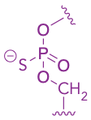

RNA Backbone Modifications Improving Potency Across RNA Modalities
(R/S)-Phosphoryl
guanidine
(R/S)-Mesyl
exNA
Neutralizes negative charge
Increases lipophilicity
Improves potency across
multiple modalities
Multiple PN-containing
assets in clinic (known safety)
Decreases protein binding compared to PS
Improves potency, durability,
and safety across
multiple modalities
Likely multiple Ms-containing
assets in development
Extends internucleotide length
Improves nuclease resistance, siRNA stability and exposure across multiple tissues
Likely multiple exNA-containing
assets in preclinical studies
Kandasamy et al, NAR, 2022
Zhang et al, NAT, 2022
Yamada et al, BioRxiv, 2023

Slide 16
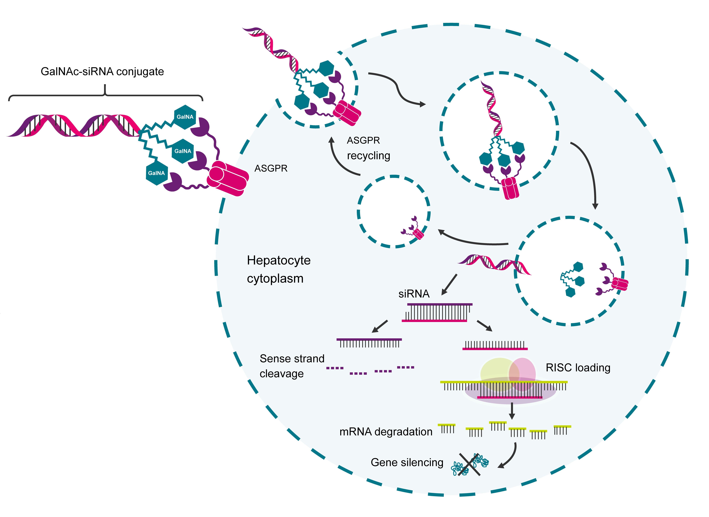
Winning with GalNAc: Decades of Innovation Enabling siRNA Delivery to Liver
1965
Discovery of ASGPR
GalNAc defined as preferential ASGPR ligand
1970s
1980s
GalNAc-modified plasmid DNA delivery to hepatocytes
GalNAc-modified oligonucleotides
1990s
2010s
Massive innovation in RNA chemical modifications
Multiple GalNAc-siRNA in post-marketing
2020s
Springer et al,
NAT, 2018

Slide 17
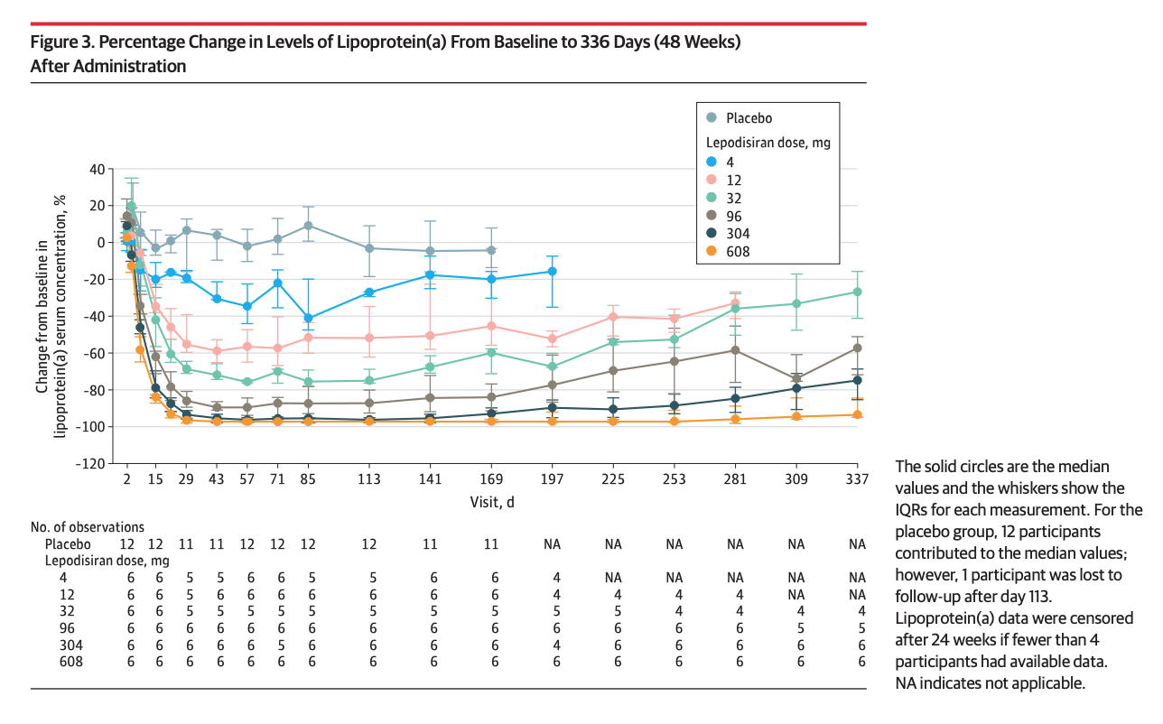
Lepodisiran, an Extended Duration siRNA Targeting Lipoprotein(a)
Lepodisiran is a GalNAc-conjugated Lp(a) siRNA developed by Lilly for atherosclerotic cardiovascular disease, for which there are no approved pharmacological treatments
In a Phase I study, lepodisiran was well tolerated and produced dose-dependent, long-duration reductions in serum lipoprotein(a) concentrations following a single dose
Lepodisiran is being evaluated in a Phase III ACCLAIM-Lp(a) trial
Nissen et al., JAMA, 2023

Slide 18






“Finding the Next GalNAc”: Extrahepatic Delivery is the Next Frontier
Human genomics yielding new liver targets and substrate for GalNAc-conjugated siRNA¹
ASOs dominate this space, but unconjugated
RNA platforms advancing for renal indications⁴
Many wins in clinical intrathecal delivery for both unconjugated ASOs and siRNAs with
simple lipophilic conjugates²
TfR-based shuttles are being evaluated
for promise in CNS-wide delivery and
deep brain penetration⁵
Small molecule siRNA conjugates (integrin a_{v}b₆) enabling clinical efficacy following
inhalation in lung³
A variety of bioconjugates emerging with
promise for durable muscle delivery⁶
¹Backman et al., Nature, 2022
²Mummery et al, Nat. Med., 2023
³Arrowhead Pharmaceuticals, 2023 ARO-RAGE Press Release
⁴Regulus Therapeutics, 2023 RGLS8429 Press Release
⁵Barker et al, BioRxiv, 2023
⁶Malecova et al, NAR, 2023

Slide 19

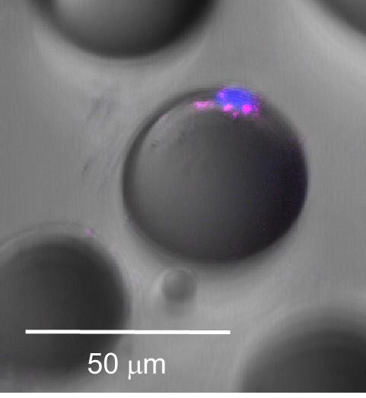
Leveraging Lilly Expertise to Enable Selective siRNA Delivery to Adipose
Conjugated siRNA delivery
to inguinal white adipocytes
Adipose-Selective Gene Silencing Following
Single Subcutaneous Administration in Mice (14 Days)
Conjugated siRNA Delivery to Inguinal White Adipocytes
iWAT image: Mature fraction live cell imaging (20X); Blue = DNA, Red = siRNA

Slide 20



Leveraging Lilly Expertise to Enable siRNA Delivery Across the BBB
Conjugated siRNA delivery
to inguinal white adipocytes
IV to Brain Delivery of Antibody-Conjugated siRNA in Mice
(q1w, IV, 28 days)
TfR1
specific ARC
Relative mRNA expression [%]
mAb
siRNA
linker
PBS Non-ARC ARC-siRNA
siRNA
Figures made by BioRender

Slide 21

Leveraging Lilly Expertise to Enable siRNA Delivery Across the BBB
Conjugated siRNA delivery
to inguinal white adipocytes
IV to Brain Delivery of Antibody-Conjugated siRNA in Mice and NHP
(Single dose, IV, 28 days)
PBS
1 mpk
10 mpk
TfR1
specific ARC
Relative mRNA expression [%]
Relative mRNA expression [%]
mAb
siRNA
linker
siRNA Dose (mpk)
Figures made by BioRender

Slide 22
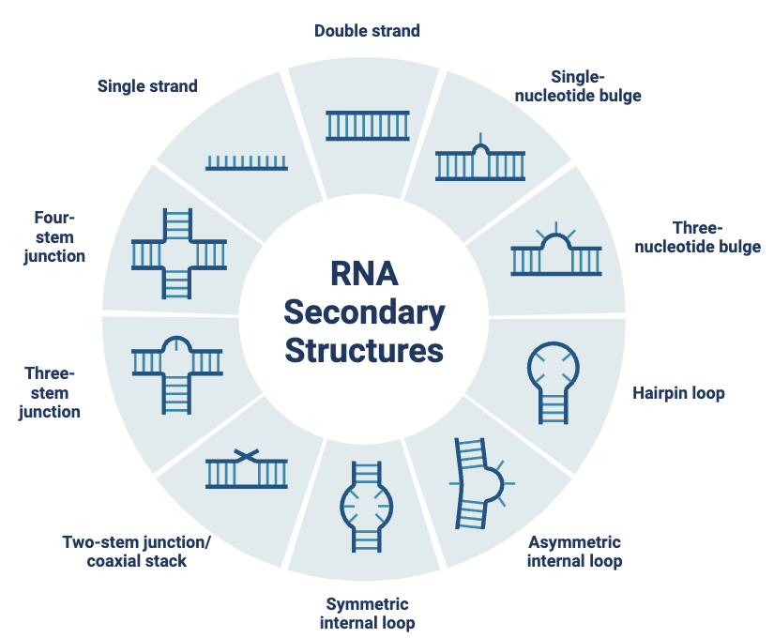
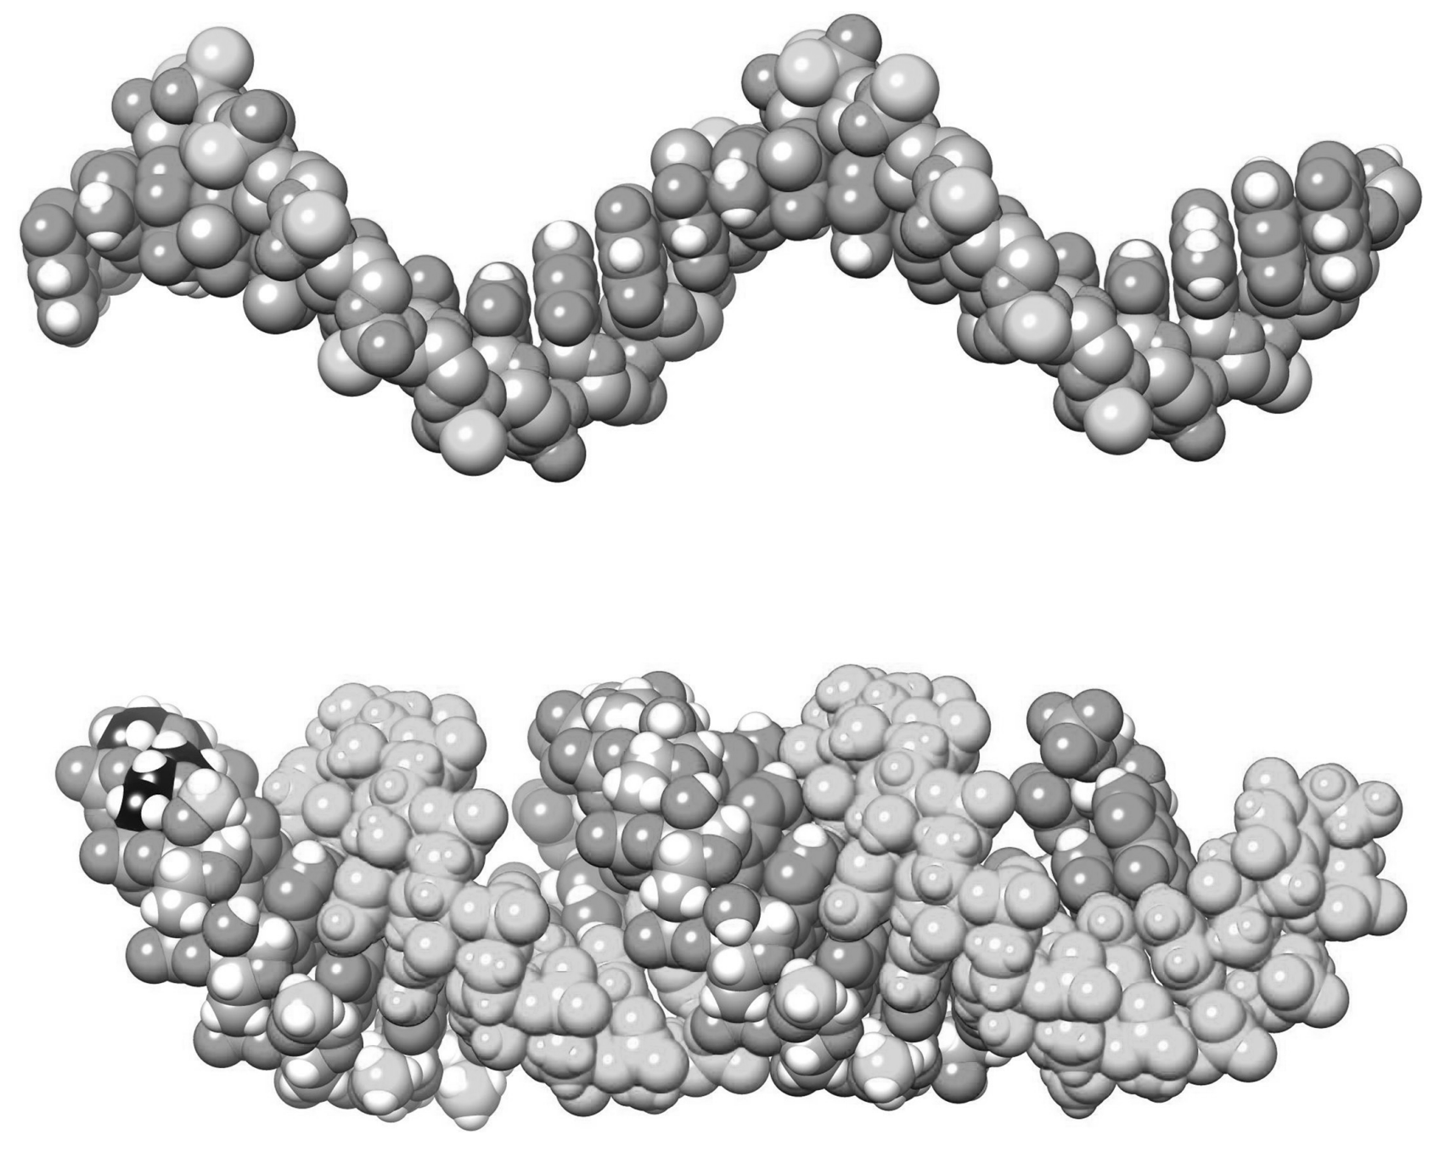
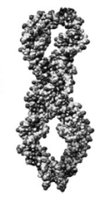
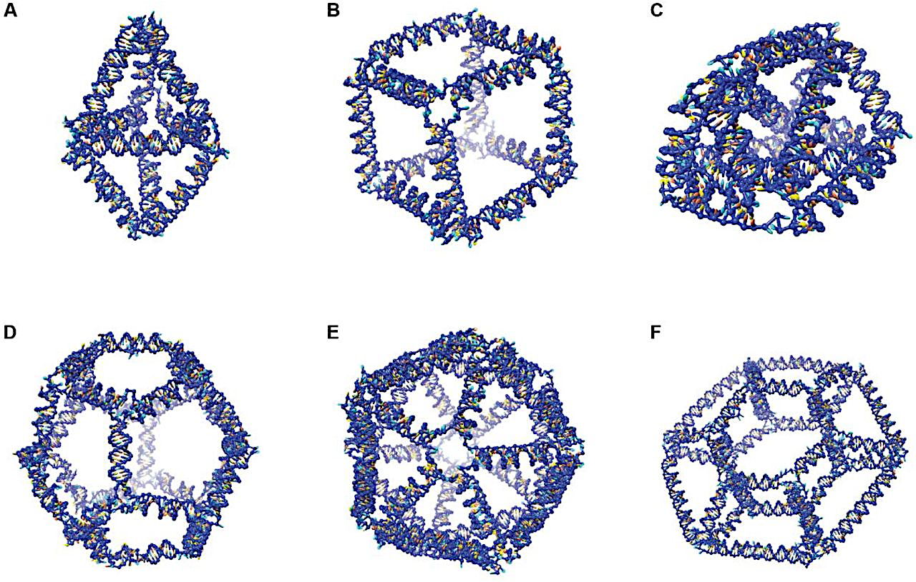
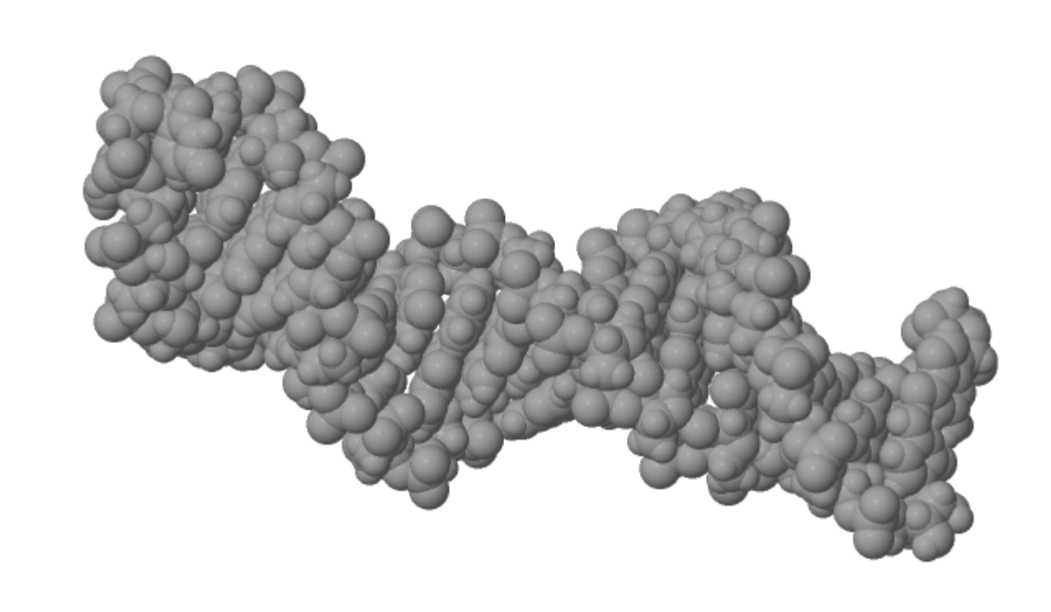
Untapped Potential of Modulating RNA Architecture
RNA tertiary and quaternary structure influence plasma stability and clearance, nuclease resistance, biodistribution (especially when delivered locally), subcellular localization, mechanism and potency
RNA
Secondary
Structures
Single-stranded RNA
Duplex RNA
Circular RNA
Hairpin RNA
Higher Order RNA Structures
Adapted from Egli & Manoharan, NAR, 2023

Slide 23

What is the Future of Chemical Innovation in siRNA?
Clinical data feedback on potency, durability, and safety, particularly in extrahepatic tissues
Emergence of ML/AI based approaches to chemical engineering
Application of RNA therapeutics in diseases with more complex etiology, enabling clinical functional genomics
Maximizing of the impact of nucleic acid medicines in patient lives

Slide 24


The Lilly Institute for Genetic Medicine, Boston, MA
“Lilly will focus on medicines acting at the nucleic acid level to advance an entirely new class that target the root cause of diseases, an approach that is fundamentally different than today’s traditional medicines.”

Slide 25
Notes:
Slide 1
Wealth of genetic information available
Multiple pathways to using synthetic oligonucleotides to manipulate gene expression to correct driving pathology behind disease
Slide 2
Potential – 1000s of patients suffering from well-defined genetic disease; ability to precisely target pathways in diseases with complex etiology to create durable solutions that compete with biologics and sm mol
How to maximize impact? We ask this question a lot
Many companies with many different approaches (company slide)
Slide 3
Challenge – engineering synthetic oligos to efficiently deliver to tissues with targets of high conviction
Slide 4
Abridged Timeline of oligo chemistry (a decade in review)
2014
Slide 5
Oligo chemistries of the future
vignette
Slide 6:
Shuttles of future
vignette
Slide 7: outlook on why chemistry is critical

Slide 26
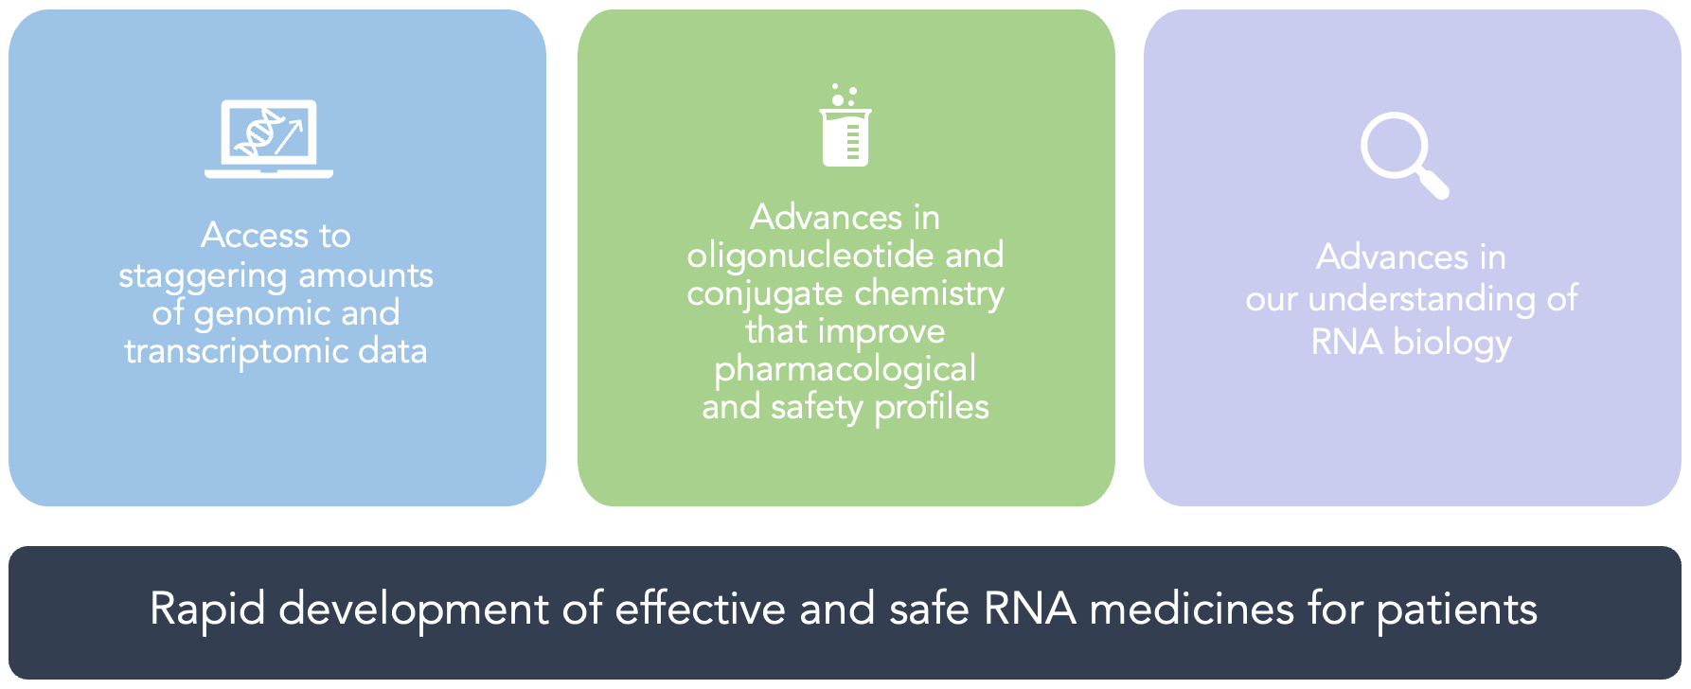
The Timing is Right to Deliver on the Promise of Oligonucleotide Therapeutics
Notes:
My pleasure to share with this audience why the timing is right to deliver on the promise of genetic medicines. First is the volume of omics data that is being generated – the national institude of estimates that in the next 10 years we will generate over X gigabytes of data, which would fill the laptops of over 200 million computers. This data helps us further understand the root cause of known genetic diseases but also being to untangle the etiology of more prevalent diseases with complex etiology. Second, we have made enormous advances in our understanding of RNA biology – both in how our genes are regulated and in how our immune system responds to foreign genetic material, leading to a variety of different ways we can use nucleic acids to reverse and correct disease pathogenesis. Finally, we’ve made enormous progress in oligonucleotide and conjugate chemistry to improve potency and safety, now with clinical data in hand. Together, we are at a point where we can think about further accelerating RNA medicines for patients.

Slide 27
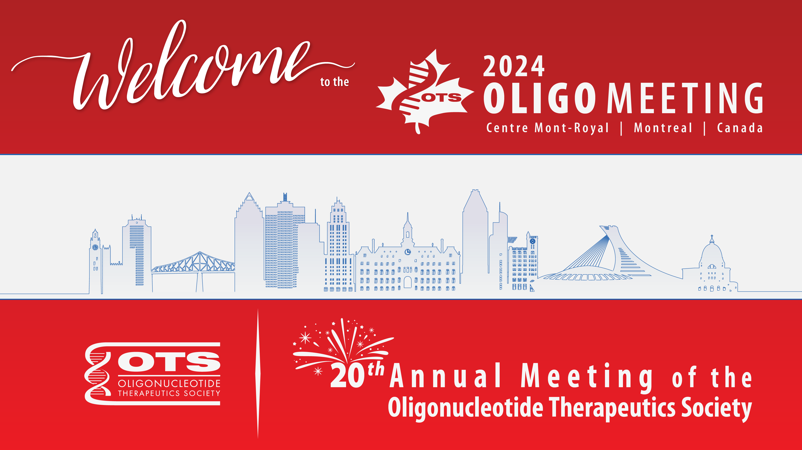

Slide 28

Establishment of in vitro models for identification of ASOs with inflammatory profile
Mahnoush Bahjat PhD
Associate Director, Immunotoxicology Team, Safety Innovation Department
Clinical Pharmacology & Safety Sciences,
AstraZeneca R&D

Slide 29
Disclosure
I am a full-time employee and shareholder in AstraZeneca.
I have no further conflict of interest to disclose.

Slide 30
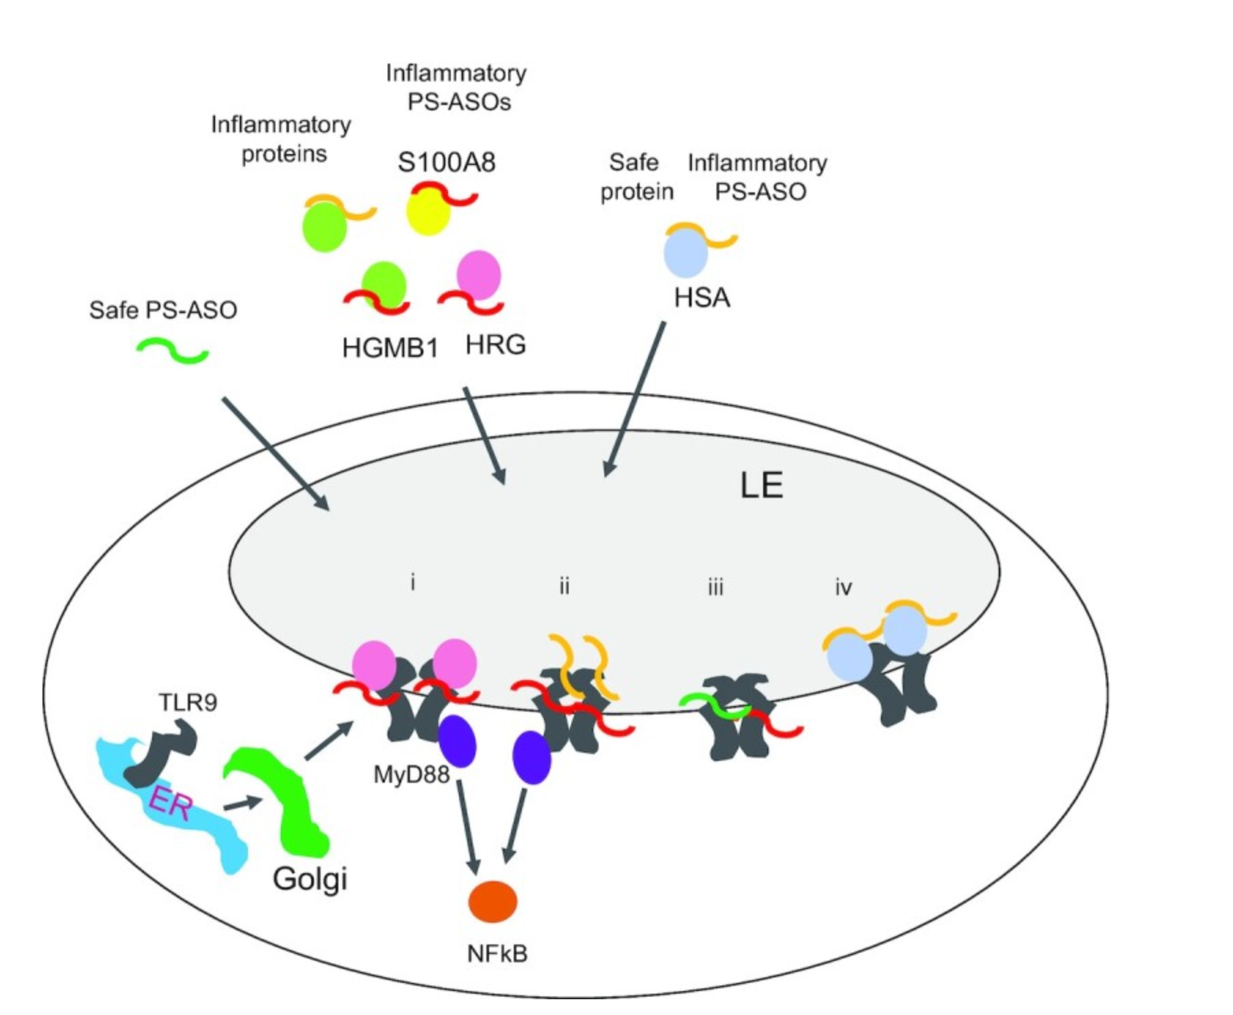



Immune safety risks associated with PS-ASOs
Risks
Proposed Mechanism
Pro-inflammatory response
(flu-like symptoms, injection site reactions)
Recognition by PRR (mainly via TLR9) leading to innate immune activation and immune cell infiltration ^{1,2}.
Undefined mechanism for injection site reaction.
Complement activation (NHP specific)
Inhibition of CFH (as negative regulator of complement alternative pathway) ^{3,4,5}.
Anti-drug Ab formation
Not defined
No safety risk identified from currently available data
While TLR9 has been shown to be the main receptor, other receptor such as RAGE are also playing a role ².
The sequence and length of the sequence are important parameters influencing immune response by non-CpG ODNs.
Thrombocytopenia
ASO nonspecific binding to GPVI and platelets aggregation ^{6,7}.
Increased in total IgM, anti PLT IgM and/or antiPF4 IgM, in concert with monocyte activation leads to decreased peripheral PLTs ⁸.
1. Pollak et al. , 2022, Nucleic acid research
6. Sewing et al. , 2017. PLoS Pne.
7. Slingsby et al., 2022, Haemmatologica
8.Narayanan et al., 2018, Toxicological Sciences
2. Paz S., et al. , 2017, Nucleic Ac id Ther
3. Engelhardt, J. Et al., (2015). Toxicol Pathol.
4. Henry et al. , 2014, Nucleic Acid Ther
5. Shen et al. , 2014, Randomized Controlled Trial

Slide 31
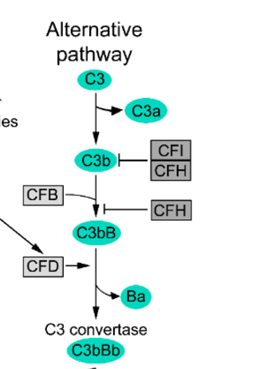
Immune safety risks associated with PS-ASOs
Risks
Proposed Mechanism
Pro-inflammatory response
(flu-like symptoms, injection site reactions)
Recognition by PRR (mainly via TLR9) leading to innate immune activation and immune cell infiltration ^{1,2}.
Undefined mechanism for injection site reaction.
Complement activation (NHP specific)
Inhibition of CFH (as negative regulator of complement alternative pathway) ^{3,4,5}.
Anti-drug Ab formation
Not defined
No safety risk identified from currently available data
Thrombocytopenia
ASO nonspecific binding to GPVI and platelets aggregation ^{6,7}.
Increased in total IgM, anti PLT IgM and/or antiPF4 IgM, in concert with monocyte activation leads to decreased peripheral PLTs ⁸.
The PS ASO backbone interacts and inhibits complement Factor H (CFH) , a negative regulator of alternative Pathway ^{3,4,5}.
Our aim: establishing in house in vitro models to identify ASOs with pro-inflammatory and complement activating property before GLP tox studies.

Slide 32
Factors to consider for in vitro assay development for ASO screening
Tool Molecules used for measuring pro- inflammatory response | Reference
ION-518477-MOE | Paz S., et al. 2017, Nucleic Acid Ther
ISIS 353512 | Burel et al.2022. Nucleic Ac id Ther
Drisapersen | Drisapersen safety, FDA doc
Volanesorsen | FDA doc
LY2181308 | Tanioka et al. 2011, Clinical Trial
ION-421856 | Paz S., et al. 2017, Nucleic Acid Ther
Inotersen | Inotersen FDA doc
ION-518477-LNA | LNA version of ION-518477-MOE (Paz S., et al. 2017, Nucleic Acid Ther )
ISIS369645 | Fey et al. 2014, inhalation toxicology
Right cell type
Expression of right receptor
Primary immune cells vs cell line (for a higher throughput)
Right cell density, right concentration and timepoint
Right readouts
Cytokine
Gene transcript
Reporters
Right tool molecules for measuring the right inflammatory manifestation
Pro-inflammatory response vs complement activation
Tool Molecules used for complement assay | Reference
ISIS42615 | Shen et al, 2014, J Pharmacol Exp Ther.
ISIS 183750 | Shen et al, 2014, J Pharmacol Exp Ther
Mipomersen | FDA doc.

Slide 33
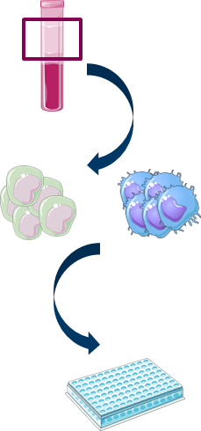
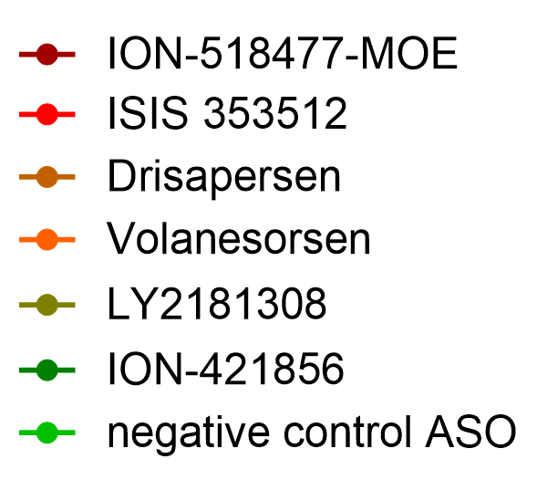
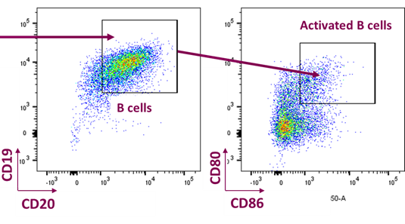
Assessing the suitability of primary B cells for inflammatory ASO screening
PBMC assay
Primary B cell activation & cytokine secretion
B cell activation in mono- culture
B cell activation in co- culture
PBMC
B cell were chosen as target immune population based on:
Pollak et al, 2021 findings
Isolated B cells
Isolated T cells
culture with Asos 24h
Deep immune phenotyping
B/T cell proliferation
Cytokine production
CD80 and CD86 as B cell activation markers
IL-6 secretion
Activation of CD4 T cells
Pg/ml
N=3
N=7
B cell activation markers including CD86,CD80 and IL-6 cytokine response can be used for ASO screening
Notes:
Add lines

Slide 34
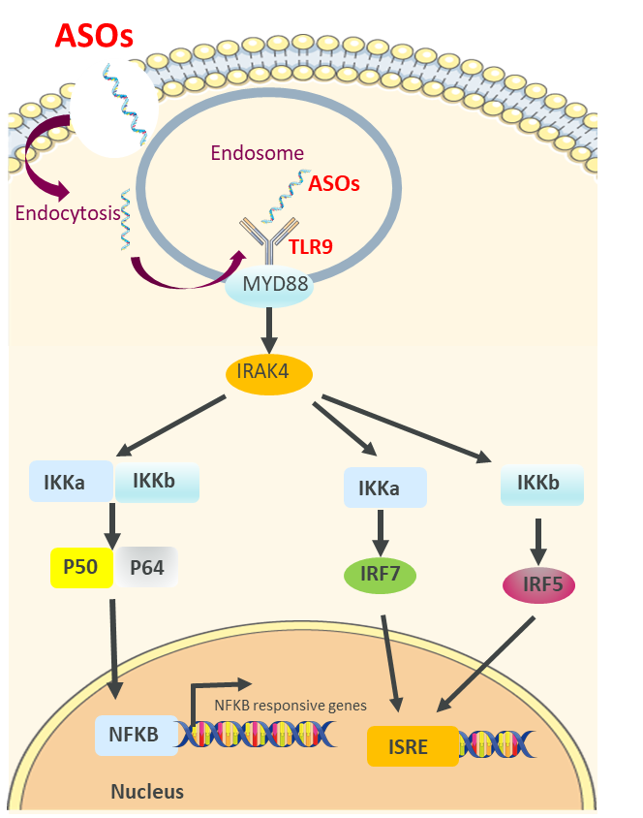
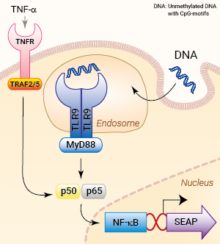
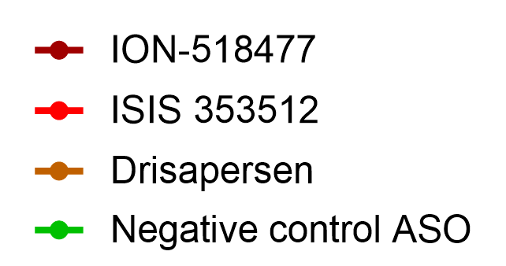
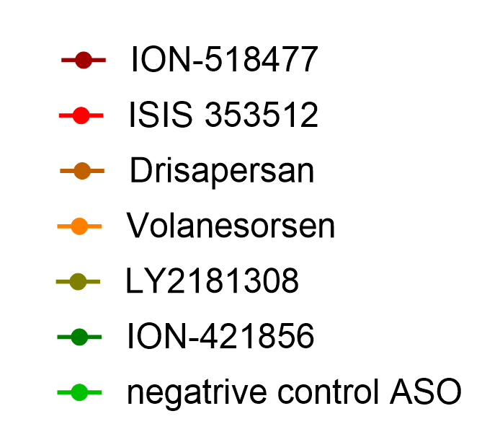
Does TLR9 expressing cell lines respond to inflammatory ASOs?
THP1-Dual™ hTLR9 reporter Cells
HEK-Blue™ hTLR9 reporter cell line
BJAB cell line ¹
TNF-α Cytokine
Luminescence was measured at several time points, 24hr depicted below.
SEAP was measured at several time points, 18hrs shown below.
TLR 8 &TLR9 important players in inducing an inflammatory response to ASOs
THP-1-TLR9 cells only showed IRF response to highly inflammatory ASOs.
Same as THP1 cells, HEK293-TLR9 cells only showed response to highly inflammatory ASOs.
TNF-α response was shown to be the most robust cytokine secreted by BJAB cells and was further adapted for screening
1. Pollak et al, 2021, BioRxiv
Notes:
THP-1-derived macrophages and human primary fibroblasts were also assessed with low sensitivity to ASOs.

Slide 35


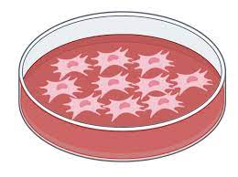
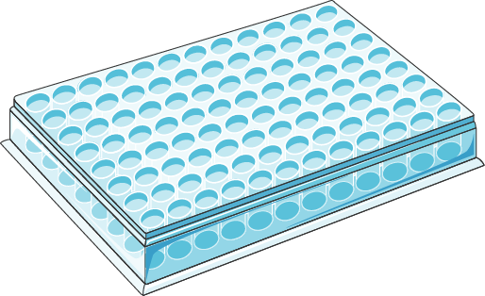
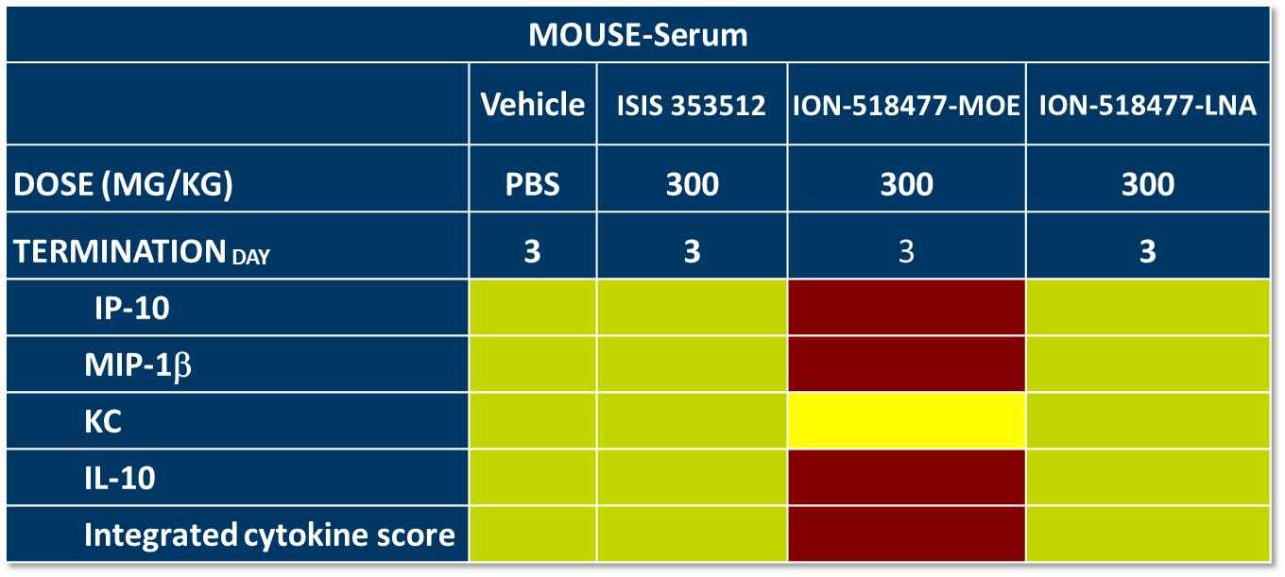
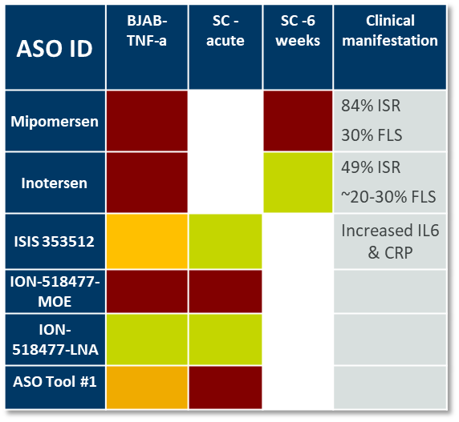
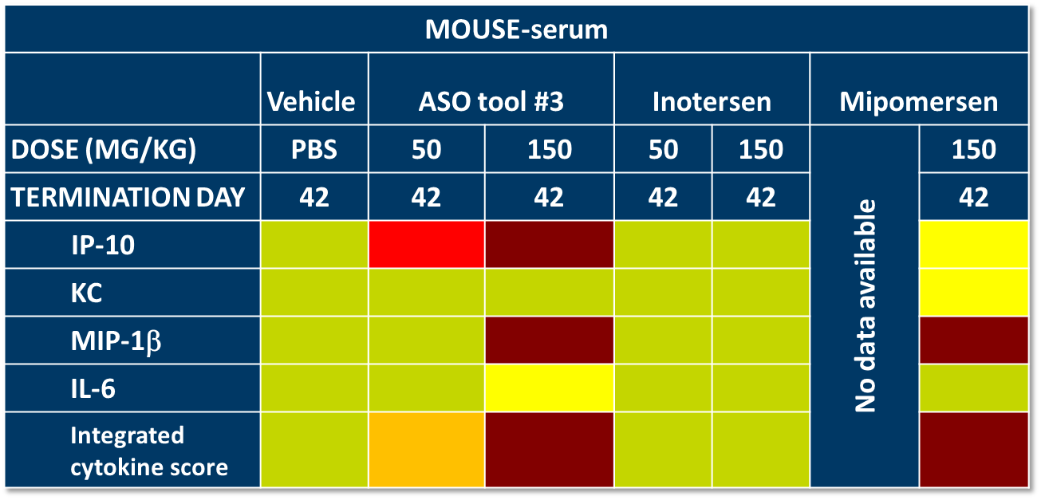
How does in vitro BJAB response translate to in vivo mouse cytokine data
Assess a large panel of ASOs
Cytokine assessment of in vivo studies
Assay translatability
24h ASO treatment
Sc
72h
TNF-α response from BJAB assay was compared to integrated acute cytokine response from benchmark in vivo studies
Cytokine profiling
BJAB
6 weeks
MCP-1, KC, IP-10, IL-6, MIP-1β were shown to be the most up-regulated cytokine in in vivo mouse studies.
The Assay translatability has been further validated using project ASOs

Slide 36
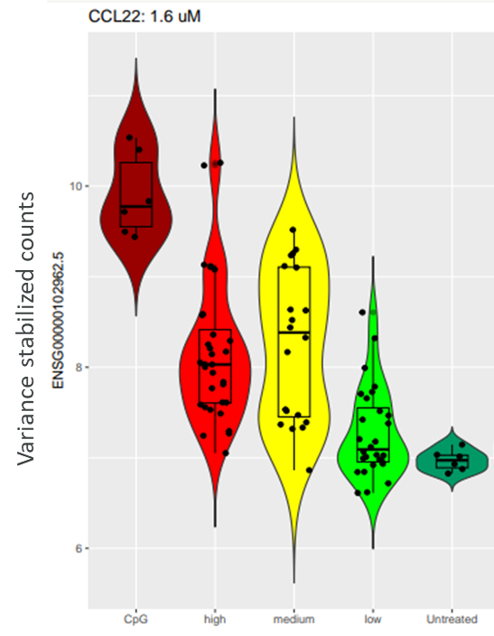
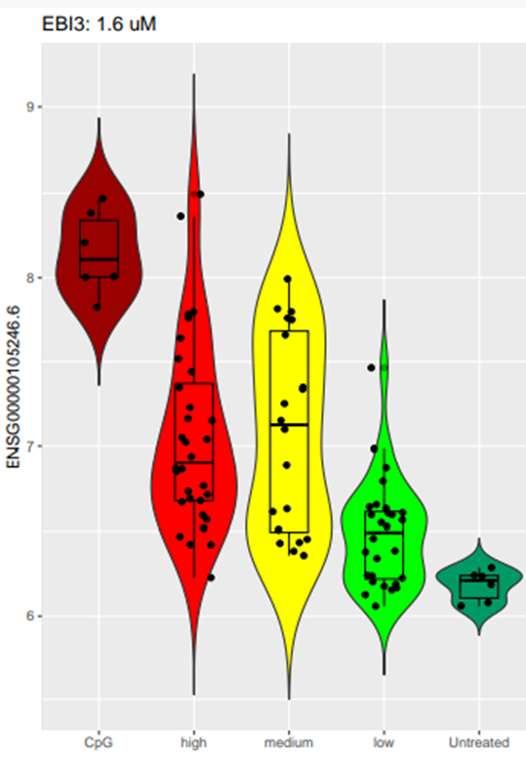
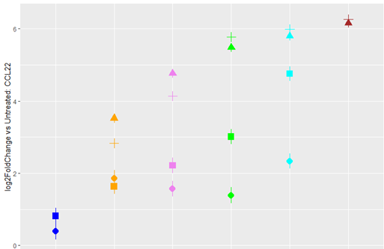
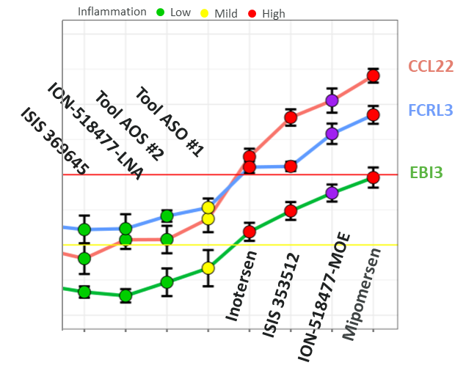
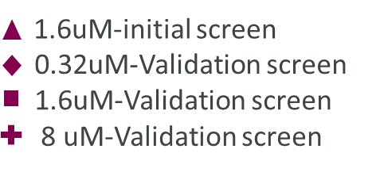
Identification of gene signature for prediction of ASOs with inflammatory profile
Proof of principle study
Validation of the findings with a larger panel of ASOs
24h ASO treatment
Correlation with in vivo mouse integrated cytokine response
Correlation with ASOs with clinical pro-inflammatory manifestations
Transcriptome analysis
CCL22
EBI3
CCL22
BJAB
RNA-seq transcriptomics analysis
Inotersen
ISIS 353512
Mipomersen
Tool ASO#1
ION-518477-MOE
(not clinical molecule)
Negative control
Transcriptomics data was shown at 1.6uM con.
Inflammatory response
Inflammatory response
Inflammatory response
Inflammatory response
Inflammatory response
*SSTR2, LTB and FCRL3 were other identified hits.
CCL22 transcript measurement can increase screening speed with improved sensitivity for mid-range inflammatory ASOs
Pollak et al, 2021, BioRxiv

Slide 37
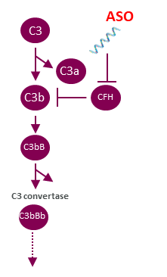

Development of an in-house in vitro complement assay for identification of ASOs with complement activating profile
Concept of the experiment
in vitro assay development
In vivo (NHP) correlation
ASO ID | In vitro | In vivo (Bb level)
ISIS 183750 |  | Bb and C3a in NHP
ISIS42615 |  | Bb in NHP
Mipomersen |  | Bb in NHP
Tool ASO#16 |  | No observed in complement NHP
C5b-9
30 min ASO treatment
NHP serum, complement preserved
C5b-9 (TCC) detection
N=5
Multiple kit providers and end points including Bb, C3a and C5a were assessed. However, SVAR TCC (C5b-9) assay provided the most reproducible readout in our hands.
ISIS42615 induced Bb in NHP upon repeated SC dosing (Shen et al, 2014, J Pharmacol Exp Ther).
ISIS 183750 induced C3a and Bb in NHP upon IV infusion (Shen et al, 2014, J Pharmacol Exp Ther).
Mipomersen cause elevation of Bb upon SC and IV injection in NHP (FDA doc.).
Notes:
Consider correlation

Slide 38






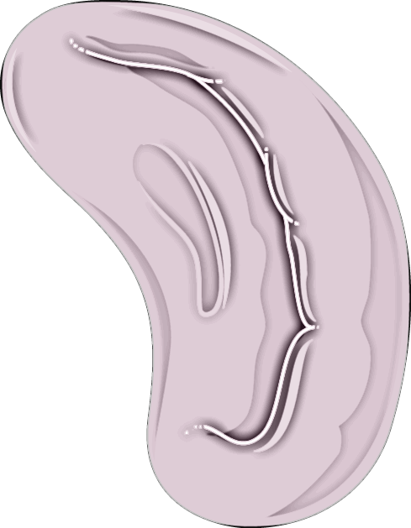




Summary and remained challenges:
In vitro models and readouts
In vivo Models
Cell line-based Assay (BJAB Assay)
Serum cytokine analysis
Human Primary PBMCs
Hemotology and histopathology
In vitro complement assay using NHP serum
Lymphoid organs weight
Ex vivo complement (C3, Bb, C3a)
CCL-22 gene expression
Remained challenges:
BJAB assay have a lower likelihood identifying ASOs AEs associated ISRs (Patridge et al. Clin Transl Sci, 2023)
No in vitro models exist today that recapitulate or predict ADA risk in patients following ASO treatment.
Unclear translation between tox species and human.

Slide 39

Acknowledgements
AstraZeneca-Safety Sciences
Catherine Betts
Patrik Andersson
Stephanie Bates
Simone Arienti
Katy Saide
Kelly Evans
Sebastian Prill
Paul Fitzpatrik
Mamun Majumder
Marie Kalm
Jennifer Tan
Kim Clarke
Laura Setyo
Janice Pfeiff
Jorrit Hornberg
Stefan Platz
AstraZeneca-Discovery Sciences
Shalini Andersson
Anders Dahlen
Mattias Bood
Anders Gunnarsson
Tom Baladi
Siavash Kijani
Annabelle Biscan
David Gilot
Krishna Sreenivasan
Laura Stanicek
Erica Backstrom
Mattias Bood
Juhi Sardana

Slide 42

Increasing GLP-1 receptor agonists efficacy targeting miR-22, a new therapeutic approach in Obesity
The Oligo Meeting 2024, Montreal, CA
Riccardo Panella, PhD

Slide 43


Disclosure
I am a founder, shareholder, member of the board of directors and CSO of Resalis Therapeutics srl I am an inventors of patents and patent applications related to miR-22 in cancer and metabolism, owned by Beth Israel Deaconess Medical Center-Harvard Medical School and Aalborg University and licensed to Resalis Therapeutics srl.

Slide 44
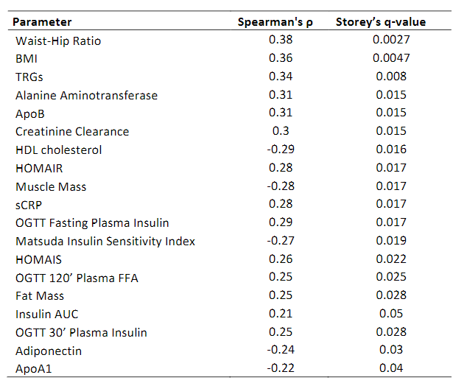
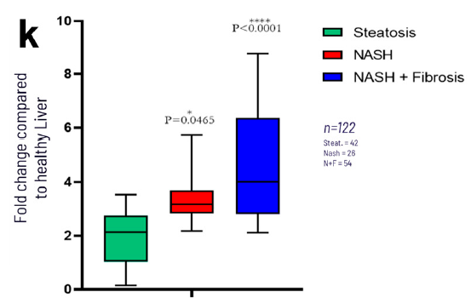
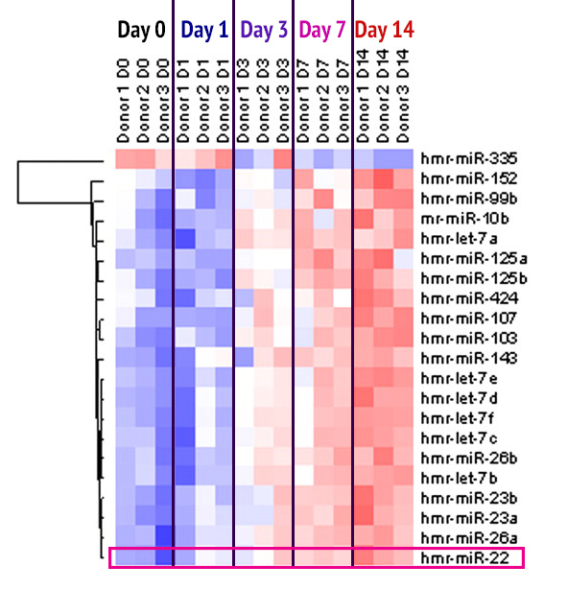
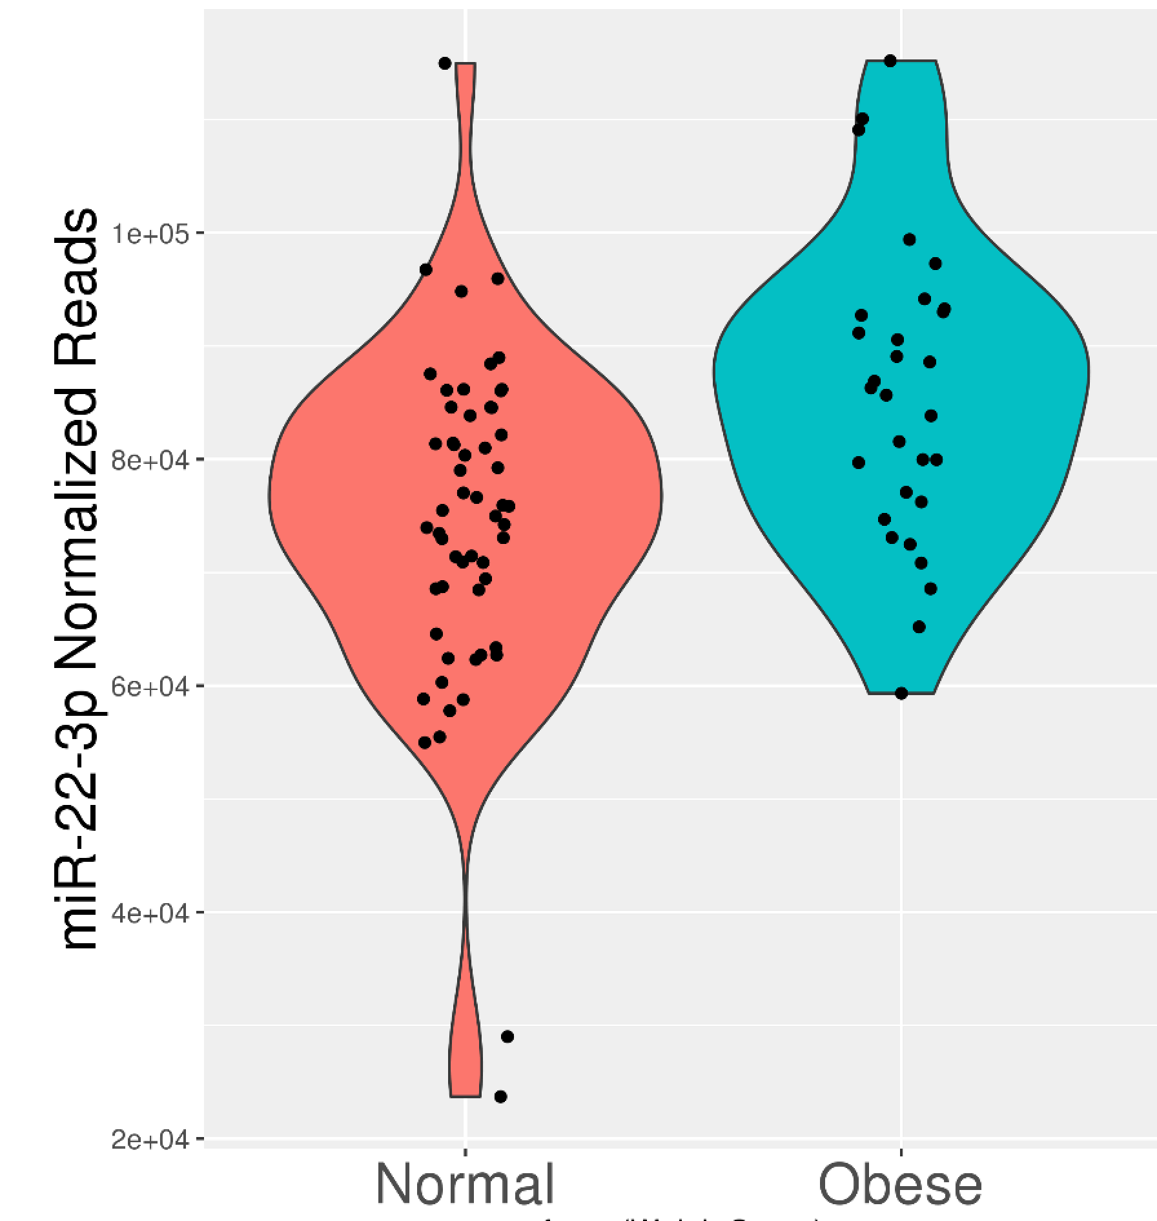
miR-22 is upregulated in people with MASH or living with obesity
Elevated levels of miR-22 in human subjects could represent a physiological mechanism favoring energy and lipid accumulation. While this mechanism may be beneficial under fasting or starvation, overexpression of miR-22 could become detrimental under consumption of high-calory diet resulting in weight gain and obesity.
Our data suggest that inhibition of miR-22 function could represent a new therapeutic strategy for obesity and liver steatosis.
miR-22 is upregulated in human abdominal subcutaneous adipose tissue samples in subjects fed with HFD and is overexpressed in obese subjects
Abdominal subcutaneous fat tissue miR-22 expression correlates with metabolic and anthropometric characteristics.
miR-22 level directly correlates with disease progression in human patients, from steatosis to F1-F2 to F3-F4 fibrosis stage
44
Adapted from Oskowitz et al. PNAS, 2008
Ref: Civelek et al: Hum. Mol. Genet. 2013, 22, 3023
Ref: Panella et al: Int. J. Mol. Sci. 2023, 24, 12870
Not to be distributed without written consent from Resalis

Slide 45
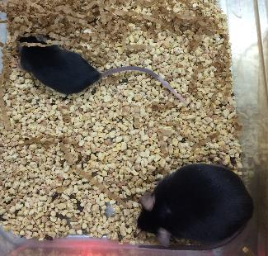
Genetic evidence for the role of miR-22 in mice
 |  | miR-22 KO | miR-22 WT | miR-22 overexpressed
Body weight | Normal diet | Normal weight | Normal weight | Obese
 | High Fat Diet | Normal weight | Obese | Obese (> 60 g)
Liver steatosis | Normal diet | Not detected | Not detected | Grade 2-3, with inflammation foci
 | High Fat Diet | Minor (grade 1, few animals), no inflammation | Grade 2-3, some inflammation foci | Very strong, grade 3, strong inflammation
miR-22 in mice
KO
overexpr
Selected literature:
Metabolic and energetic benefits of microRNA-22 inhibition. BMJ Open Diabetes Research and Care. Thibonnier, M et al., 8(1), e001478, 2020
miR-22 inhibition reduces hepatic steatosis via FGF21 and FGFR1 induction. Hu, Y et al., JHep Reports, 2(2), 100093, 2020
miR-22 modulates brown adipocyte thermogenesis by synergistically activating the glycolytic and mTORC1 signaling pathways. Lou, P et al., Theranostics 2021; 11(8): 3607-3623.
MircoRNA-22 is a Key Regulator of Lipid and Metabolic Homeostasis. Panella, R et al., 2023. Int. J. Mol. Sci., 24, 12870.
Not to be distributed without written consent from Resalis
Notes:
stella

Slide 46
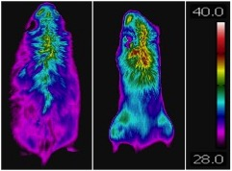


Genetic loss of miR-22 results in profound metabolic changes
Reduced lipid biosynthesis
KO models maintain their body weight on HFD with no change on food consumption
Echo MRI revealed that miR-22 genetic ablation is affecting fat mass deposition
Increased energy expenditure via BAT activation
Thermal pictures of WT and KO after 8 weeks on HFD, increase signal in the intrascapular area where BAT is located while Oxigen consumption increased
Increased transformation of White Adipose Tissue into Brown Adipose Tissue
Increased BAT and show sign of brownization of WAT
Weight gain on HFD
Body composition on HFD
Oxygen consumption
WT
KO
A
WT
KO
A
A
100
WT
KO
80
A
60
40
20
0
WT KO
WT KO
Day 0
Week 8
Lean mass
Fat mass
Ref: Panella et al: Int. J. Mol. Sci. 2023, 24, 12870. https://doi.org/10.3390/ijms241612870
Not to be distributed without written consent from Resalis

Slide 47

RES-010: A potent miR-22 antagonist
Advantages of the RES-010 lead compound
The locked nucleic acid (LNA) chemistry provides increased binding affinity to target without affecting bioavailability
LNAs are synthetic RNA analogues, when incorporated into a short DNA molecule effectively bind a complementary RNA sequence
RES-010 is a LNA/DNA mixmer antisense oligonucleotide (ASO) designed to specifically target miR-22
Resalis’ CTO and scientific co-founder, Prof. Sakari Kauppinen, is a pioneer in LNA chemistry with profound expertise in development of non-coding RNA medicines
Currently, 9 ASO therapies have been approved in the United States and Europe. Among the last approved, Vitolarsen and Casimersen were approved for Treatment of Duchenne muscular dystrophy.
Other LNAs are currently in development; see for instance Cardior’s CDR132L (anti-miR-132) in Heart Failure just aquired by Novo Nordisk
Not to be distributed without written consent from Resalis

Slide 48




RES-010 inhibition of miR-22 affects multiple metabolic pathways
Increased mitochondria biogenesis and fatty acid oxidation
More mitochondria, more energy expenditure, as in the KO model
VHL
RES-010
miR-KO
Reduced lipid biosynthesis
Impaired lipid biosynthesis, as in the miR-22 KO model
Increased transformation of White Adipose Tissue into Brown Adipose Tissue
Strong signs of browning in WAT, as in the miR-22 KO model
RES-010
ACLy
Plzf/Zbtb-16
ACLy
ACLy
ACLy
miR-KO
VHL
RES-010
RES-010
Ref: Panella et al: Int. J. Mol. Sci. 2023, 24, 12870. https://doi.org/10.3390/ijms241612870

Slide 49












RES-010 modulates multiple genes, in distinctive pathways converging on Obesity
ENHO
TIMP3
CyP7a1
SP1
FASN
≥ 2-fold
Early response
0,5 to 2-fold
Energy homeostasis associated gene, inverse correlation with body weight and liver fat
Associated with MASH progression
Cholesterol processing enzyme, high expressed in MASH
Transcriptional regulator of metabolic relevant genes
Mediates pro-inflammatory and fibrogenic signaling
0,5 to 2-fold
≥ 2-fold
Increase mitochondria & energy expenditure (including BAT)
Decrease lipid biosynthesis
Decrease liver steatosis
Increases initiation of
gluconeogenesis
DGAT2
Increases fatty acid metabolism
FGFR1
PPARα
FOXO1
ACLy
Increases last step of gluco-neogenesis
Promotes fatty acid oxidation
Sirt1
Promotes lipolysis and BAT differentiation
Late response
FGF21
Reduces fatty acid metabolism
Favours atherosclerotic plaques
THRβ
Increases fatty acid metabolism
Apo B
Reduces
cholesterol
PLZF
(Zbtb16)
SREBP-1c
PGC-1α
Increases T cell activation, promotes inflammation
HSD17B13
TCF7
Promotes BAT differentiation
Stimulates cholesterol biosynthesis
Increases mitochondria biogenesis
Reduces hepatic lipids
Source: RNAseq analysis on liver mice tissues treated for 3 or 15 weeks

Slide 50


RES-010 increases mitochondria biogenesis and activity in mice and NHP
Mitochondrial biogenesis in liver tissues
Mitochondrial biogenesis in musculoskeletal tissues
Vehicle
Vehicle
RES-010
RES-010
Mitochondrial activity in liver tissues
Mitochondrial activity in musculoskeletal tissues
All data are in base 10 logarithmic scale. All data are normalized to their internal control and a VHL treated.
Not to be distributed without written consent from Resalis

Slide 51




RES-010 effect on mitochondria activity is confirmed in human cell line
RES-010
RES-010
Not to be distributed without written consent from Resalis

Slide 52






RES-010 induces brownization of WAT in mice and NHP
Increased transformation of White Adipose Tissue into Brown Adipose Tissue
Strong signs of browning in WAT of mice, as in the miR-22 KO model
Relevant brownisation detected also in all treated primates as a result of the 6-months treatment
Study design
Study design
High Fat Diet
(N=5)
(N=3)
R
(N=5)
R
Fast Food Diet
HFD until 40g
HFD+scramble
Fast Food Diet
(N=4)
HFD+RES-010
(N=5)
Fast Food Diet + RES-010
13 weeks
30 months
6 months
Liver biopsy
Liver and WAT collection
Staining of UCP-1 in WAT
Plzf/Zbtb-16
% of Stained Area
miR-KO
VHL
RES-010
52

Slide 53





RES-010 induce browning in a 3D human adipose tissue model
Study design
3D ExAdEx human WAT model
differentiation
3D ExAdEx human WAT model (Lipoaspirate of subcutaneous human adipose tissue obtained from a subcutaneous body fat depot of a donor displaying a BMI=30.7):
RES-010 induced a statistically significant upregulation of hUCP1 and hPGC1α gene expression
RES-010 confirms in a human setting its dose-dependent browning capacity
Interestingly, while RES-010 induces brownization by reducing the level of miR-22, brownization induced by rosiglitazone results in lower levels of miR-22 as well
Day 0 Day 7 Day 14
Vehicle control
Vehicle control + rosiglitazone
RES-010 5 µM
RES-010 0.5 µM
RES-010 0.05 µM
Harvesting for gene expression
miR-22 expression
UCP1 expression
PGC1α expression

Slide 54


RES-010 does not affect body weight in non-obese animals
Mice treated with RES-010 show weight loss despite high fat diet: while weight loss is promptly observed in obese mice at baseline, it is not observed in mice lean at baseline until they become overweight but not yet obese.
Study design
Study design
(N=5)
High Fat Diet
HFD
(N=5)
High Fat Diet
R
HFD+scramble
HFD
(N=5)
R
(N=5)
HFD until 40g
PREVENTIVE
HFD+scramble
CURATIVE
(N=5)
HFD+RES-010
(N=5)
HFD+RES-010
HFD
16 weeks
13 weeks
3 weeks
Obese mice on high fat diet lose weight within few weeks: miR-22 pharmacological inhibition induces a statistically significant weight loss in obese mice under a DIO protocol (-20% vs baseline)
Lean mice do not lose weight. Only after having gained a sufficient amount of weight as fat mass, RES-010 acts in a way they lose weight despite high fat diet
Body Weight
Body Weight
Single mouse curves for RES-010
Single mouse curves for RES-010
Days on treatment
Days on treatment
54
Ref: Panella et al: Int. J. Mol. Sci. 2023, 24, 12870

Slide 55
RES-010 does not affect body weight in non-obese animals
24-weeks NHP in different HFD diets (Effect on body mass change and lipid profile)
Two different long-lasting experiments in superior species with two different diets (Fast Food and GAN diet) confirm that RES-010 at 5mg/kg selectively acts on those subjects with an excessive amount of fat and works as long as this condition remains
Study design
Study design
Fast Food Diet
(N=3)
GAN Diet
(N=6)
Fast Food Diet
R
GAN Diet
R
Fast Food Diet + RES-010
(N=4)
GAN Diet + RES-010
(N=7)
30 months
Liver biopsy
6 months
Liver and WAT collection
30 months
Liver biopsy
5 months
Liver and WAT collection
VHL
RES-010 5mg/kg
Single NHP curves for RES-010 5mg/kg/w

Slide 56

RES-010 increase the effect of diet by promoting body weight loss via fat mass reduction
Switching obese mice from HFD to Regular Chow (restricted calories diet) results in weight loss. However, mice on RES-010 treatment fed with RC, perform better than RC alone over time (-12.5% vs -2%)
During 22 weeks of treatment with RES-010, the animals lose significant amount of fat mass while they gain lean mass
Relative change in body composition in the RES-010 arm (week 22 vs baseline)
RESTRICTIVE STUDY
Body Weight
Grams
Regular Chow
RES-010
Study design
Regulat Chow
(N=5)
HFD until 40g
R
(N=5)
RC+RES-010
22 weeks
Single mouse curves for RES-010
Weeks on treatment
Not to be distributed without written consent from Resalis
56

Slide 57


Ability of RES-010 to reduce fat mass is confirmed in theremoneutrality condition
Study design
HFD Diet
(N=13)
12-weeks DIO male mice on HFD diet in thermoneutrality (Effect on body mass change, body composition, food and energy consumption)
The weight loss observed between weeks 6 and 12 results in substantial fat mass reduction while the muscles are preserved
The percentage of fat mass goes parallel with the total body weight
HFD Diet
R
(N=14)
HFD Diet + RES-010
Male mice at 28°C
38 weeks
12 weeks
Body composition
Body composition
VHL
RES-010

Slide 58



RES-010 metabolis benefits are maintained after treatment interruption
Study design
30-weeks DIO female mice on HFD diet (Effect on body mass change and lipid profile)
During the treatment phase, RES-010 induces weight loss despite HFD, showing a better performance than a calory restricted diet
Once interrupted the treatment with RES-010, the mice keep losing weight for other 8 weeks while on HFD and then the weight is stabilized
Plasma lipids (Triglycerides and LDL) are reduced by the treatment and remain low for several weeks after treatment discontinuation
High Fat Diet
HFD
(N=4)
HFD until obese
R
Calory restriction
Calory restriction
(N=4)
HFD+ RES-010 10mg/kg
HFD
(N=4)
17 weeks
13 weeks
Treatment
Observation
Weight loss
Plasma Triglycerides
Plasma LDL
Single mouse curves for RES-010 10mg/Kg
Triglycerides conc., ng/uL
LDL conc., mg/dL
Absolute Weight, grams
Last injection
Weeks
Vehicle
RES-010
Calory restriction
Ref: data on file

Slide 59
RES-010 increases the efficacy of GLP1-RA
Study design
24-weeks DIO-MASH male Mice on GAN diet (Effect on % body mass change)
The combination RES-010+semaglutide shows better results vs semaglutide in terms of weight loss
Better response at 24 weeks is experienced in all mice with the combination
After 12 weeks of treatment, many more mice on combination are no longer obese; and animals treated with the combination keep losing weight in the following 12 weeks of treatment
GAN Diet
(N=18)
R
GAN Diet + RES-010
(N=18)
GAN Diet
GAN Diet + Semaglutide
(N=18)
GAN Diet + RES-010 + Semaglutide
(N=18)
38 weeks
Liver biopsy
24 weeks
Liver and tissue collection
Weight change (weeks 12-24)
Relative body weight, %
VHL
RES-010
Semaglutide
RES-010+Semaglutide
Semaglutide RES-010+Semaglutide
Days

Slide 60
RES-010 has an additive effect on GLP1-RA on hepatic parameters
24-weeks DIO-MASH male Mice on GAN diet (Effect on liver parameters)
The combination RES-010+semaglutide outperforms each monotherapy in terms of hepatic lipids
The combinations demonstrate better ability to clear hepatocytes from lipid droplets thus providing better inflammatory profile
After 24 weeks treatment, mice treated with the combination show a trend to lower biomarkers reflecting liver injury related to fibrosis development
Liver lipids
Liver structure
Liver injury
Not to be distributed without written consent from Resalis

Slide 61
RES-010 might provide an alternative therapeutic paradigm for people living with obesity
We propose a new treatment approach with:
initial induction phase with RES-010 in combination with a GLP-1
followed by chronic consolidation with RES-010 monotherapy
with potential drug-free periods or infrequent treatments
treatment
GLP-1 ra
vs
GLP-1 + RES-010
RES-010
Drug-free
1. 2. 3.

Slide 62




RES-010 MoA is orthogonal to GLP1-RA
Addresses symptoms (appetite)
Rewires cellular metabolism
RES-010 is the perfect fit for a GLP-1 agonist: its disease-modifying mode of action complements the fast effect of food intake reduction

Slide 63

Resalis - ncRNA medicines in metabolic diseases
Transformative approach for metabolic diseases by targeting a non-coding RNA, miR-22, a master regulator of the molecular pathways underlying obesity
Lead program RES-010 is an Antisense Oligonucleotide initially developed for obesity and fatty liver disease
RES-010 provides disease-modifying therapeutic impact, including quality and sustained weight loss.
RES-010 rewires cellular metabolism:
Restores regulation of lipid biosynthesis
Promotes the biogenesis of mitochondria
Transforms white adipose tissue into brown adipose tissue
The activation of these pathways leads to a fat mass reduction in all body districts including fat pads and liver
Not to be distributed without written consent from Resalis

Slide 64
Sakari Kauppinen Anja Holm Mirolyuba Ilieva Simone Tomasini Francesco Margiotta Ulrik Scheele Jens Madsen
Lluis Riera Ponsati Vibeke Thomsen Clara Mayer
Anna Altieri
Alessandro Toniolo Micheal Hodges Emanuele Monteleone Luca Borgio
Barbara Domizzi
Almut Nitsche
Thank you
riccardo.panella@resalistherapeutics.com

Slide 65




miR-22 levels are triggered by an excess of energy intake, which is the primary cause of obesity in our society
We observed that, in wild type mice, plasmatic level of miR-22 is increased on High Fat Diet (HFD) regiment.
There is a trend to readjust the miR-22 level towards normal level overtime even if, still after 16 weeks, the level is significantly higher than baseline.

Slide 66


miR-22 inhibition can represent a valid strategy to restore a metabolic healthy status

Slide 67













Resalis at a glance
Company
Founded 2021 by pioneers in ncRNA drug discovery and development
Proprietary discoveries from Harvard Medical School and RNA Medicine Center, Copenhagen
Alessandro Toniolo, PhD
CEO
Dr. Almut Nitsche
CDMO
Pipeline
Lead candidate RES-010 and 2nd generation candidate RES-020
Multiple completed and ongoing preclinical PoC studies with up to 6-months treatment
Designed as single agent or use in combination with GLP-1 agonists
20-year experience in top pharma companies in executive commercial roles (Previously at Novartis, Pfizer, Merck)
Experienced leader in the field of incretins drug discovery at Sanofi, research and clinical development
Prof. Riccardo Panella
Scientific Founder &
CSO
Prof. Sakari Kauppinen
Scientific Founder &
CTO
Associate Professor at Center for RNA Medicine, Aalborg University, Denmark
Professor and Director, Center for RNA Medicine, Aalborg University, Denmark
Business/Financing
€ 10 M seed funding in place
€ 10 M Series A finalized led by Sunstone and Claris Ventures
Luca Borgio, PhD
Head of Operations
Prof. Emanuele Monteleone
Preclinical Research Associate
Anna Altieri
Translational Research Associate
Barbara Domizzi
Budget Planner
10-year experience in the role on drug and device development
Ex-Novartis, coordinating projects and budget allocation
Supporting preclinical and clinical activity
15-years of academic genetic research
Not to be distributed without written consent from Resalis

Slide 68


RES-010 inhibition of miR-22 causes cellular rewiring
Mice and Human mesenchymal cells cultured in Adipo differentiation media for 2 weeks show a reduced ability to become fully committed adipocyte when treated with RES-010
WT
miR-22 KO
SCR
SCR
RES-010
RES-010
Ref: data on file
Not to be distributed without written consent from Resalis

Slide 69
Evidence generation
3
mice genetic models
>10
4
Efficacy and safety of RES-010 have been tested in multiple models, from mice to human organoids
in vivo studies
diets tested
3
3
long studies in NHP
human organoids
Not to be distributed without written consent from Resalis

Slide 70



RES-010 inhibition of miR-22 causes cellular rewiring
In mouse 3T3L1 cells (pre-adipocytes) treatment with RES-010 produces a metabolic rewiring resulting in a preferential differentiation in brown vs white adipocytes as confirmed by morphology and gene activation
Vehicle
3T3L1 cells with RES-010 differentiate into brown adipocytes
3T3L1 cells with VHL mature into white adipocytes
RES-010
Not to be distributed without written consent from Resalis

Slide 71






RES-010 shows significant, time-dependent thermogenic effect in human white adipose spheroid model (inSphero)
3D InSphero human WAT model (3D adipose model derived from human primary pre-adipocytes):
RES-010 confirms in a human setting its browning capacity outperforming the standard cocktail
This is demonstrated by inducing a time-dependent reduction of the ability of the organoids to produce ATP, which is a clear thermogenic outcome
Also in this model, while RES-010 induces brownization by reducing the level of miR-22, brownization induced by standard approach results in lower levels of miR-22 as well
Vehicle control for RES-010
RES-010
RES-010
RES-010
RES-010
RES-010

Slide 72
RES-010 acts also under thermoneutral conditions with no difference in food intake
12-weeks DIO male mice on HFD diet in thermoneutrality (Effect on body mass change, body composition, food and energy consumption)
To ensure that RES-010 MoA is not affected by the temperature of the environment, a body weight loss study was done at 28°C on mice fed with HFD
The effect of RES-010 on body weight becomes evident after 3 weeks, when the curves split apart. At 12 weeks, RES-010 treated mice weigh 15% less than the non treated siblings, with no difference in food consumption.
Body Weight
Food Consumption
Study design
Grams
Relative Body Weight, %
HFD Diet
(N=13)
HFD Diet
R
(N=14)
-15%
HFD Diet + RES-010
Male mice at 28°C
38 weeks
Body composition
12 weeks
Body composition
Days on treatment
Days on treatment
Not to be distributed without written consent from Resalis

Slide 73


Once RES-010 has activated its metabolic pathways, benefits are directly observed in the liver
Study design
24-weeks DIO-MASH male Mice on GAN diet (Effect on liver parameters)
As seen for the weight loss induction, no major effect is observed in the first 12 weeks in this model fed with GAN diet
In the following 12 weeks, however, when RES-010 has impacted on the transcriptome, we see remarkable effect on liver injury as described by the Galectin-3 and α-SMA parameters
R
GAN Diet
(N=18)
GAN Diet
GAN Diet + RES-010
(N=18)
24 weeks
38 weeks
Liver biopsy
Liver biopsy
Liver and tissue collection
Liver Galectin-3
Liver α-SMA
P=0.0204
ns; P=0.0961
VHL
RES-010
12 weeks
24 weeks
12 weeks
24 weeks
Not to be distributed without written consent from Resalis

Slide 74




Efficacy study of RES-010 in 3D liver human organoids confirms activity in a human MASH model
3D InSphero human liver model (Co-culture of primary human hepatocytes, stellate cells, Kupffer Cells and Liver Endothelial Cells) treated with RES-010 produced these observations:
Trend in reduction of inflammatory marker IL-6 at day 5
Significant reduction in intracellular triglycerides at day 10
Reduction in the fat accumulation and in the deposition of fibrosis on stained histology slides in the lean and MASH conditions.
Study design
Triglycerides, day 10
IL-6, day 5
Staining of histology slides, day 10
In Lean control
Vehicle
RES-010 0.05uM
RES-010 0.05uM
RES-010 5uM
RES-010 0.5uM
RES-010 0.05uM
RES-010 0.5uM
RES-010 5uM

Slide 75



Clinical development plan and timelines
2025
2026
2027
Q4 | Q1 | Q2 | Q3 | Q4 | Q1 | Q2 | Q3 | Q4 | Q1 | Q2 | Q3 | Q4
FPI
LPO
Phase 1a SAD
Phase 1a 1-m MAD
FPI=first patient in
LPO=last patient out
DBL=database locked
dCSR=draft cliniocal study report
CSR=clinical study report
CTA=clinical trial authorization
FPI
LPO
DBL
dCSR
CSR
Phase 1 b
dCSR
CTA
DBL
SAD/MAD (MAD 1 month treatment) in The Netherlands
then a Phase1b (3 months treatment) in Germany
then a Phase 2a (6-9 months treatment, tbd)

Slide 76
FIH dose selection and top dose escalation
Max recommended starting dose and dose escalation is based on GLP- tox study (mice, NHP) and the PD study in DIO mice for target engagement
Interspecies scaling was conducted using single species scaling with cynomolgus monkey as the reported most relevant species for the prediction of human PK and distribution for oligonucleotide drugs
PK exposure predictions such that human equivalent doses (HED) can be extrapolated directly from the predicted values (1,2)
Tissue-to-plasma ratios can be assumed as constant at steady state, systemic exposure at Ctrough can be used as a surrogate to inform on organ accumulation and guide dose selection.
The anticipated PD in human range is 14 mg to 57 mg and beyond in a subject of a body weight of 70 kg
Selected MRSD for a 70 kg human subject : 14 mg/week
Selected dose ranges up to the lowest observed NOAEL in animal toxicology studies (mice GLP- tox)
Top dose of 450 mg/week (translated from the exposure in mice using a predicted human clearance from monkey (4.6 L/h).
Dose escalation up to the top dose will apply decreasing factor between dose levels (planned SAD doses: 10 mg, 40 mg, 120 mg, 300 mg, and 450 mg)
Predicted Dose Range in Human
Study | Species | HEDª mg/kg/wk (mg, human) | AUC^{b} h*ng/mL (0-24 h) | Cl_{human}^{c} (L/h) | Dose^{d} (mg)
PD DIO (RES‑002) 0.5 mg/kg | Mouse | 0.04 (2.8) | 620e | 4.6 | 2.8
PD DIO (RES‑002) 2.5 mg/kg | Mouse | 0.2 (14) | 3100e | 4.6 | 14.2
PD DIO (RES‑002) 10 mg/kg | Mouse | 0.8 (56) | 12400 | 4.6 | 56.8
GLP Tox Mean values between genders (VPT12953) 30 mg/kg/wk | Mouse | 2.4 (168) | 102100 | 4.6 | 467
GLP Tox Mean values between genders (VPT13575) 20 mg/kg/wk | NHP | 6.4 (448) | 585000 | 4.6 | 2680
HED in mg/kg: NOAEL in animals (mg/kg)×FDA conversion factor (mouse=0.08, NHP=0.32) (FDA 2005); HED (mg)=HED (mg/kg)×BW; the conversion factor from Nanavati is 0.14, since it is higher, the FDA conversion factor as more conservative estimate has been used (Nanavati et al. 2021). Human BW=70 kg.
1. Nanavati C et al, 2021 2. Yu RZ et al. 2015

Slide 77

Clinical Development Plan: proposed phase 1 study
Phase 1: RES-010 will be developed in Healthy Volunteers (SAD and MAD) and target population for Obesity
Primary endpoint: safety and tolerability of RES-010 after single and multiple subcutaneous doses
Key secondary endpoints: Plasma PK of RES-010 after single and multiple subcutaneous doses in healthy volunteers and target population. Safety, tolerability, plasma pharmacokinetics and markers of weight and metabolic liver disease
Maximum Treatment duration: 12 weeks
Phase | Cohort | Subjects | Treatment
1a | A1-A6 | Healthy Volunteers BMI: 18.5 to 25 kg/m2 (normal weight) | Part 1: SAD Escalating doses of RES-010 administered once vs placebo
1a | B1-B4 | Healthy Volunteers BMI: 1-2-3 cohorts 25 to 30 kg/m2 (overweight) 4 cohort 30-35 kg/m2 (obese) | Part 2: MAD Escalating doses of RES-010 administered vs placebo for four weeks
1b | C1 | Overweight and Obese+/-MAFLD Volunteers BMI: 27-34.9 kg/m2 (overweight and obese) | Part 3: target population for safety and early signs of efficacy Target dose of RES-010 administered for 12 weeks vs placebo (Additional arm in combination with GLP-1ra under discussion)
Not to be distributed without written consent from Resalis

Slide 79
Need ST-3

Slide 81
Need ST-4

Slide 83
Need ST-5

Slide 85
Need ST-6

